Slide 1

Web Graphics
source:https://www.w3schools.com

Slide 2


Graphics on the Web
2D Graphics
  Canvas – The <canvas> element
provides API to draw 2D graphics using javascript
  SVG – Scalable Vector Graphics
3D Graphics
  WebGL — the 3D graphics API for the Web
CSS 3D transformation & animation

Slide 3


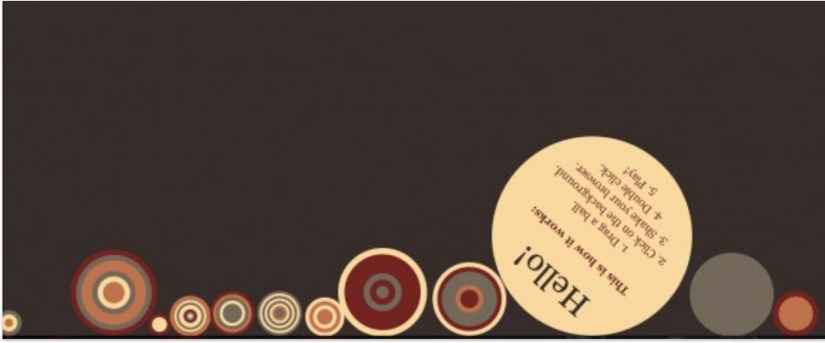
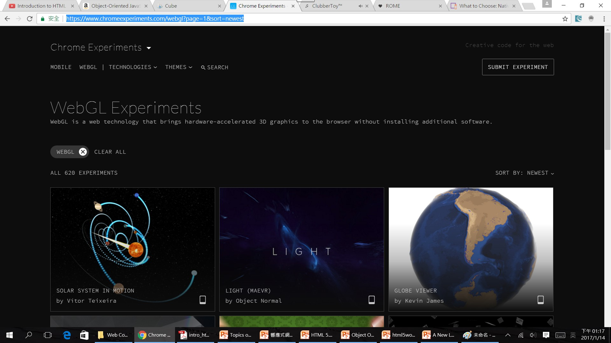
Ball Pool

Slide 4


HTML 5 Components
HTML (tag) CSS (style)
JavaScript (behavior)

Slide 5
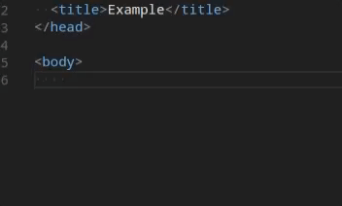
HTML5 editor in this course
Visual Studio Code - Code Editing. Redefined
  https://code.visualstudio.com/

Slide 6

HTML 5 Template
<!DOCTYPE
<html>
<head>
html>
The <!DOCTYPE html> declaration defines that this document is an HTML5 document
The <html> element is the root element of an HTML page
The <head> element contains meta information about the HTML page
The <title> element specifies a title for the HTML page (which is shown in the browser's title bar or in the page's tab)
The <body> element defines the document's body, and is a container for all the visible contents, such as headings, paragraphs, images, hyperlinks, tables, lists, etc.
The <style> tag is used to define style information (CSS) for a document. It must be included inside the <head> section of the document.
The <script> tag is used to embed a client-side script (JavaScript).
<meta charset="UTF-8">
<title>Title of the document</title>
<style> </style>
<script> </script>
</head>
<body>
Content of the document……
<script> </script>
</body>
</html>

Slide 7

Popular HTML Tag
<div style="width:100px; height:100px; background-color: coral;">…</div>
<h1></h1>…..<h6></h6>
<p>
<img src="path">
<a href="path"> link </a>
<ul>
  <li> item1</li>
  <li> item2</li>
  <li> item3</li>
</ul>
The <div> element is used as a container for other HTML elements.
HTML headings are defined with the <h1> to <h6> tags.
HTML paragraphs are defined with the <p> tag.
HTML images are defined with the <img> tag.
The source file (src), alternative text (alt), width, and height are provided as attributes.
HTML links are defined with the <a> tag. The link's destination is specified in the href attribute.
An unordered list starts with the <ul> tag. Each list item starts with the <li> tag.

Slide 8


CSS 3
CSS (cascading style sheet,階層式樣式表)
CSS is a language that describes the style of an HTML document.
CSS describes how HTML elements should be displayed.
CSS3 is the latest standard for CSS.

Slide 9
CSS 3
Selector – 更有彈性的選擇器
Webfonts – 嵌入式字體
Layout – 多樣化的排版選擇
Styling radius gradient shadow – 圓⾓、漸層、陰影
Border background – 邊框的背景⽀援
Transition – 元件的移動效果
Transform – 元件的變形效果
Animation – 將移動和變形加入動畫⽀援

Slide 10
CSS語法-Internal CSS
<!DOCTYPE html>
<html>
<head>
<style>
body {
background-color: linen;
}
h1 {
color: maroon;
}
</style>
</head>
<body>
<h1>This is a heading</h1>
<p>This is a paragraph.</p>
</body>
</html>

Slide 11



CSS element Selector
div a container for HTML elements
Selector
div {
Property: value
background-color: aqua; color:#FF0000;
border: 1px solid red; width:100px; height:100px;
text-align:center;
}

Slide 12
CSS id Selector
Selector
#id {
Property: value
background-color: aqua; color:#FF0000;
border: 1px solid red; width:100px; height:100px;
text-align:center;
}
<p id="para1">Hello World!</p>

Slide 13
CSS class Selector
Selector
.center {
Property: value
background-color: aqua; color:#FF0000;
border: 1px solid red; width:100px; height:100px;
text-align:center;
}
<p class="center">Hello World!</p>

Slide 14
CSS語法-Inline CSS
<!DOCTYPE html>
<html>
<body>
<h1 style="color:blue;text-align:center;">This is a heading</h1>
<p style="color:red;">This is a paragraph.</p>
</body>
</html>

Slide 15
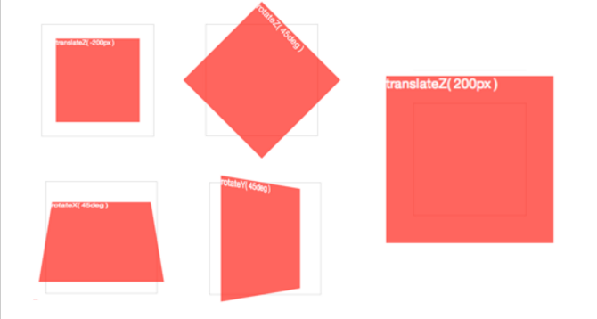
CSS3 Transformation
rotateX( angle )
rotateY( angle ) rotateZ( angle ) translateZ( tz ) scaleZ( sz )
translate3d( tx, ty, tz ) scale3d( sx, sy, sz )
rotate3d( rx, ry, rz, angle )

Slide 16
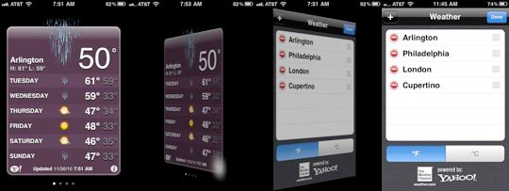
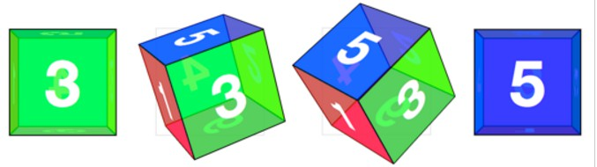
CSS3 3D Transformation

Slide 17
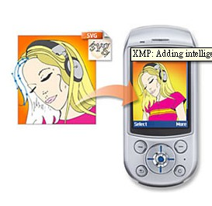
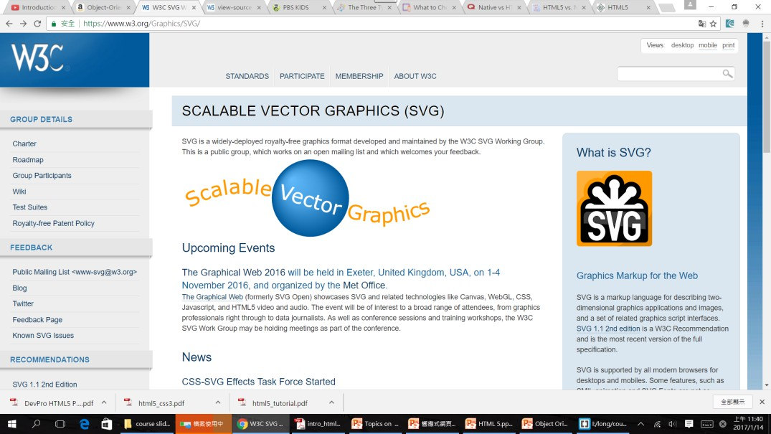
SVG (Scalable Vector Graphics)
Graphics Markup for the Web
SVG is an excellent way to create
interactive, resolution-independent
vector graphics that will look great on any size screen.

Slide 18
<!DOCTYPE html>
<html>
<head>
<script>
function doCircle(evt) {
var theCircle = evt.target;
var radius = theCircle.getAttribute("r"); if (radius == 50)
radius = 75; else radius = 50;
theCircle.setAttribute("r",radius);
}
</script>
</head>
<body>
<svg width="300px" height="300px">
<text x="25" y="50" font-size="24">SVG Circle Element</text>
<text x="25" y="275">Click the circle to change its size.</text>
<circle cx="125" cy="150" r="50" fill="pink" stroke="green" stroke-width="5" onclick="doCircle(evt)" />
</svg>
</body>
</html>

Slide 19
SVG animation
<!DOCTYPE html>
<html>
<body>
<h2>SVG animate Element</h2>
<svg width="100%" height="100" xmlns="http://www.w3.org/2000/svg">
<circle cx="50" cy="50" r="50" style="fill:red;">
<animate
attributeName="cx"
begin="0s"
dur="10s"
from="50"
to="90%"
repeatCount="indefinite" />
</circle>
Sorry, your browser does not support inline SVG.
</svg>
</body>
</html>

Slide 20

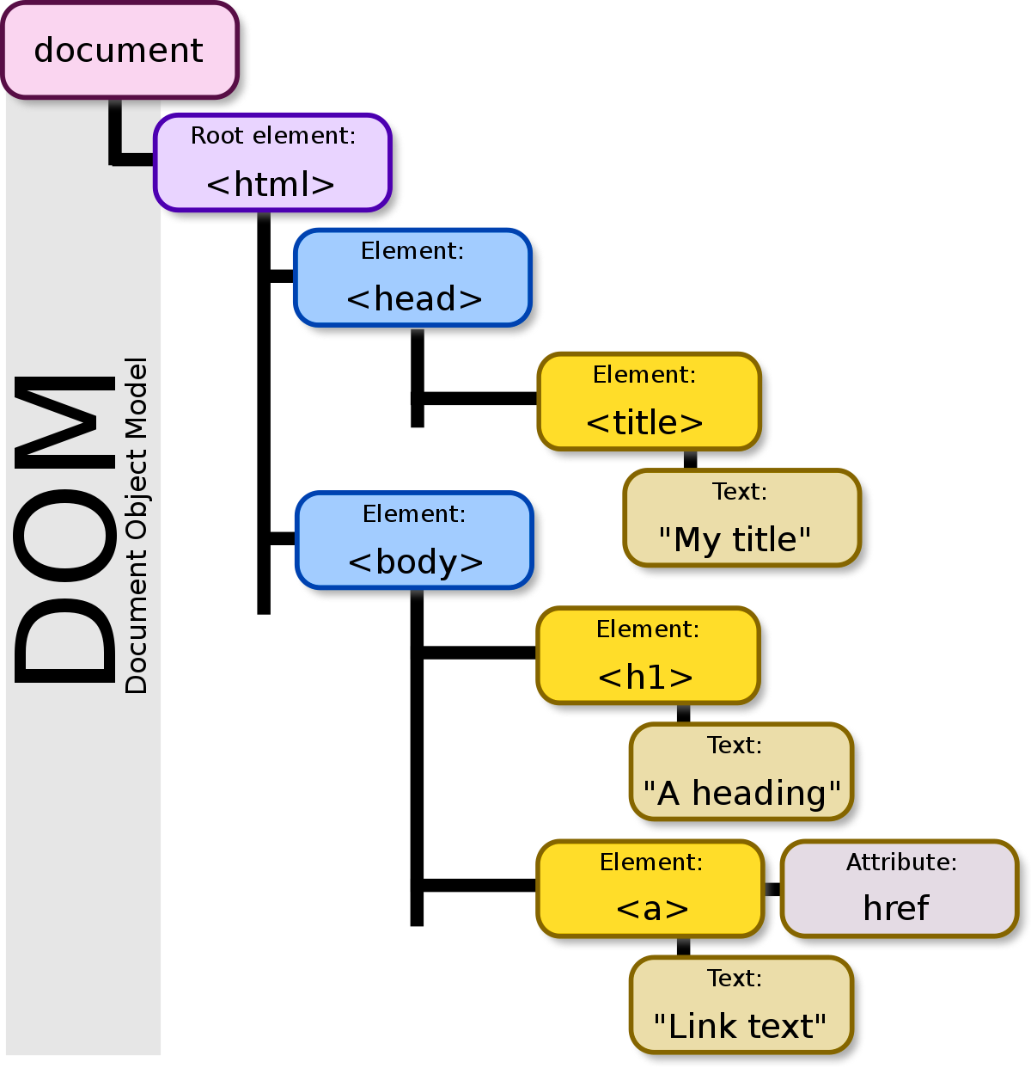
The HTML DOM (Document Object Model) —wiki
When a web page is loaded, it is created as a DOM Tree of Object by the browser.
With the HTML DOM, JavaScript can access and change all the elements of an HTML document.

Slide 21
Accessing DOM objects
getElementById Returns a reference to the first object with specified id
var btn = document.getElementById('btnSave');
getElementsByTagName Returns a live NodeList var images =
document.getElementsByTagName('img');
陣列

Slide 22

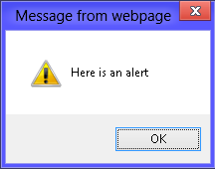
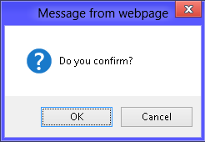
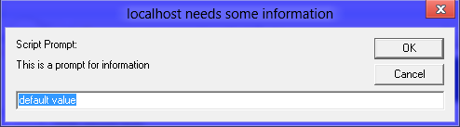
JavaScript Popup Boxes
alert("Here is an alert");
var promptResult = prompt("This is a prompt for information", "default value");
var promptResult = confirm("Do you confirm?");

Slide 23
HTML5 Canvas

Slide 24
HTML Canvas
Draw Text
Draw 2D/3D Graphics
Animated
Move
respond to JavaScript events and user action (key clicks, mouse clicks, button clicks, finger movement).
Used in Games

Slide 25






HTML Canvas
<canvas id="myCanvas" width="200" height="100" style="border:1px solid #000000;">
</canvas>
<script>
  var c = document.getElementById("myCanvas");
  var ctx = c.getContext("2d");
<canvas> element is used to draw graphics on a web page.
border: border-width border-style border-color;
The getContext() method returns an object with tools (methods) for drawing.
border - CSS：层叠样式表 | MDN
</script>

Slide 26
Draw Text: font, fillStyle
fillText(text, x, y , maxWidth)
maxWidth(Optional) The maximum text width in pixels
strokeText(text, x, y , maxWidth)
<canvas id="myCanvas" width="500" height="300"></canvas>
<script>
var canvas = document.getElementById("myCanvas");
var context = canvas.getContext("2d");
context.font = "40pt Ariel"; context.fillStyle = "blue"; context.fillText("Hello World!", 150, 100);
</script>

Slide 27


Draw a rectangle
fillRect(x, y, width, height)
Draws a filled rectangle.
strokeRect(x, y, width, height)
Draws a rectangular outline.
clearRect(x, y, width, height)
Clears the specified rectangular area, making it fully transparent.
const canvas = document.getElementById("myCanvas");
const ctx = canvas.getContext("2d");
ctx.fillStyle="#FF0000";
ctx.fillRect(20, 20, 200, 100);

Slide 28

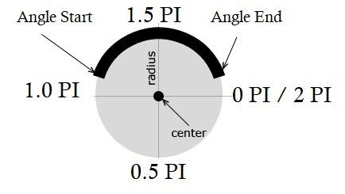
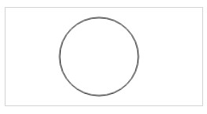
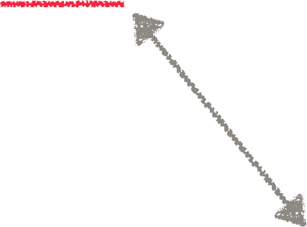
Draw a Circle
<script>
var c = document.getElementById("myCanvas"); var ctx = c.getContext("2d");
ctx.beginPath(); ctx.arc(95,50,40,0,2*Math.PI); ctx.stroke();
</script>
Don’t forget

Slide 29
Draw a Line: moveTo(), lineTo()
var canvas = document.getElementById("myCanvas"); var ctx = canvas.getContext("2d");
ctx.beginPath();
ctx.moveTo(20, 10);
ctx.lineTo(150, 80)
ctx.lineWidth = "10";
ctx.strokeStyle = "green";
ctx.lineCap = "round";
ctx.stroke();

Slide 30



Draw a Path
A path is a list of points, connected by segments of lines that can be of diﬀerent shapes, curved or not, of diﬀerent width and of diﬀerent color.
false is default
ctx.beginPath();
ctx.arc(75, 75, 50, 0, Math.PI * 2, true); // Outer circle
ctx.moveTo(110, 75);
ctx.arc(75, 75, 35, 0, Math.PI, false); // Mouth (clockwise)
ctx.moveTo(65, 65);
ctx.arc(60, 65, 5, 0, Math.PI * 2, true); // Left eye
ctx.moveTo(95, 65);
ctx.arc(90, 65, 5, 0, Math.PI * 2, true); // Right eye ctx.stroke();

Slide 31
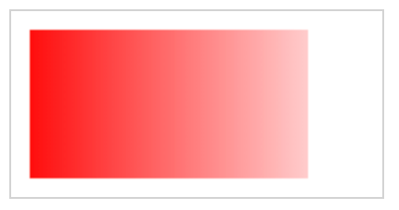
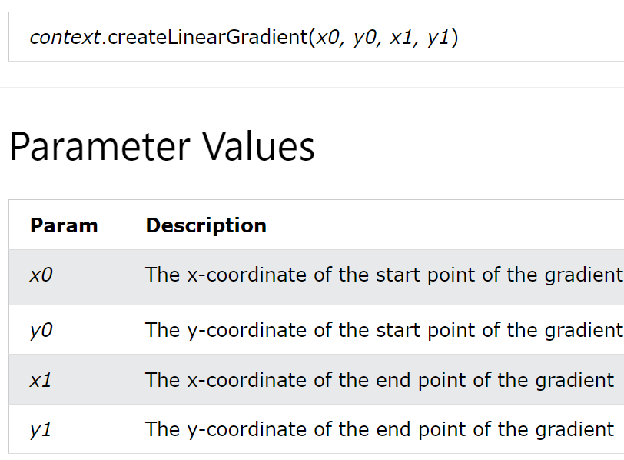

Canvas - Gradients
var c=document.getElementById("myCanvas");
var ctx=c.getContext("2d");
// Create gradient
var grd=ctx.createLinearGradient(0,0,150,0); grd.addColorStop(0,"red");
grd.addColorStop(1,"white");
// Fill with gradient
ctx.fillStyle=grd;
ctx.fillRect(10,10,150,80);
(150,0)
(0,0)
■

Slide 32
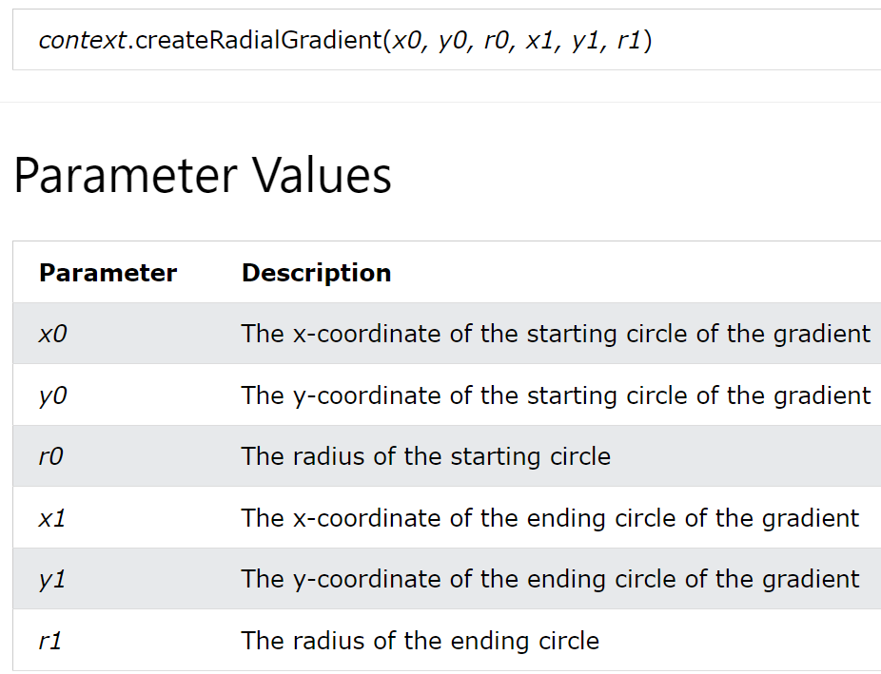
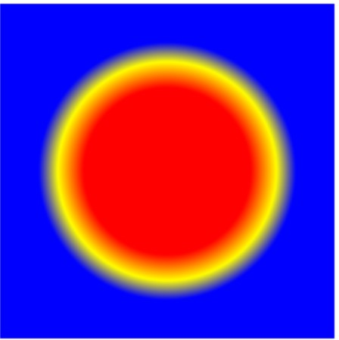

Radial Gradient
<!DOCTYPE html>
<html>
<head> <meta charset="utf-8"></head>
<body>
<canvas id ="a_canvas" width="300" height="300"> </canvas>
<script>
var canvas = document.getElementById ("a_canvas");
var ctx = canvas.getContext("2d");
var g = ctx.createRadialGradient(150,150,50,150,150,100);
g.addColorStop(0,"red");
g.addColorStop(0.5,"yellow");
■
■
■
■
■
g.addColorStop(1.0,"blue"); ctx.fillStyle = g; ctx.fillRect(20,20,260,260);
</script>
</body>
50
(150,150)
</html>

Slide 33
Load image
<!DOCTYPE html>
<html>
<body>
<img id="logo" width="220" height="277" src="logo.jpg" alt="logo.jpg">
<canvas id="myCanvas" width="240" height="297" style="border:1px solid grey;"></canvas>
<script>
const canvas = document.getElementById("myCanvas");
const ctx = canvas.getContext("2d");
const img = document.getElementById("logo");
ctx.drawImage(img, 10, 10);
</script>
</body>
</html>

Slide 34
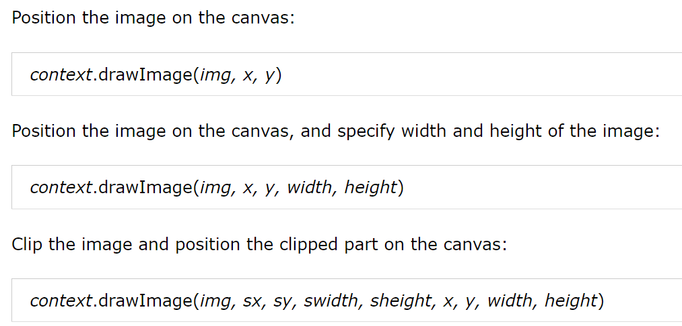
drawImage()
Param | Description
img | Specifies the image, canvas, or video element to use
sx | Optional. The x coordinate where to start clipping
sy | Optional. The y coordinate where to start clipping
swidth | Optional. The width of the clipped image
sheight | Optional. The height of the clipped image
x | The x coordinate where to place the image on the canvas
y | The y coordinate where to place the image on the canvas
width | Optional. The width of the image to use (stretch or reduce the image)
height | Optional. The height of the image to use (stretch or reduce the image)

Slide 35
Lab Time
Try to draw any interesting graph using canvas API

